Slide 1

Software Design and architecture (SE322) gg
Week 04
Said Nabi
said.nabi@giki.edu.pk
Faculty of Computer Science and engineering
Gik Institute Topi, Swabi

Slide 2
List of Topics
Decomposition Principle
UML Sequence Diagram
UML State Diagram
Model Checking
Solid Principles

Slide 3
Decomposition Principle
Use inheritance only when the subtype is a true specialization of the supertype and obeys Liskov Substitution (can stand in for its parent without breaking expectations).
Smells of misuse:
Subclass adds nothing unique (just reuses fields/methods)
Subclass overrides behavior to contradict parent’s contract
You’re using inheritance just to share code (prefer composition)
Examples:
Manager extends Employee (adds team/approveLeave)
Whale extends Animal that requires run()—breaks LSP

Slide 4
UML Sequance Diagram
Different types of UML Class diagrams are used to express technical Diagrams.
UML sequence diagrams are another important technique in software design.
: Person
: Cashier
: Chef
Order (Burger)
Order (Burger)
Burger
Burger

Slide 5
UML Sequance Diagram Cont…
Type of UML diagram, commonly used as a planning tool
before the development team starts programming.
How objects in a program interact with each other to complete tasks.
is like a map of conversations between different people, with the messages sent from person to person outlined.
Help you visualize the classes you will create in your software and determine the functions that will need to be written.
It may also illustrate problems in your system that were previously unknown.

Slide 6
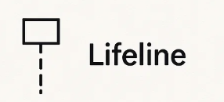
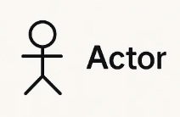
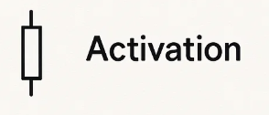
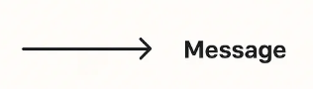
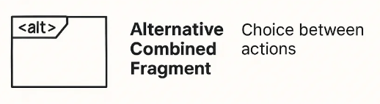
Component of a sequence diagram
Small rectangles along an object’s lifeline denote a method activation. You activate an object whenever an object sends, receives, or is waiting for a message.
People, or actors, may also be included in sequence diagrams if they use or interact with objects. Actors are typically represented with stick figures.

Slide 7
Component of a sequence diagram Cont…
Good practice is to draw objects from left to right in the sequence as they interact with each other.
Eg. Changing the channel of your television using a remote control
Can contain other sequence diagrams within them.
Creating a sequence diagram for an ATM machine (Withdrawing, balance checking)
Loops and alternative processes can also be demonstrated in a sequence diagram.

Slide 8
Change TV Channel
TV Viewer
: Remote
: Television
Press Number
Change Channel (Number)
Show Change of Channel

Slide 9
Change TV Channel
: Remote
: Television
Alt
TV Viewer
[if] The Viewer knowes what channel they want
Press Number
Change Channel
Show Change of Channel
[Else]
loop
Press up/down
Change channel up/down

Slide 10



UML State Diagrams
A technique used to describe how systems behave and respond

Slide 11
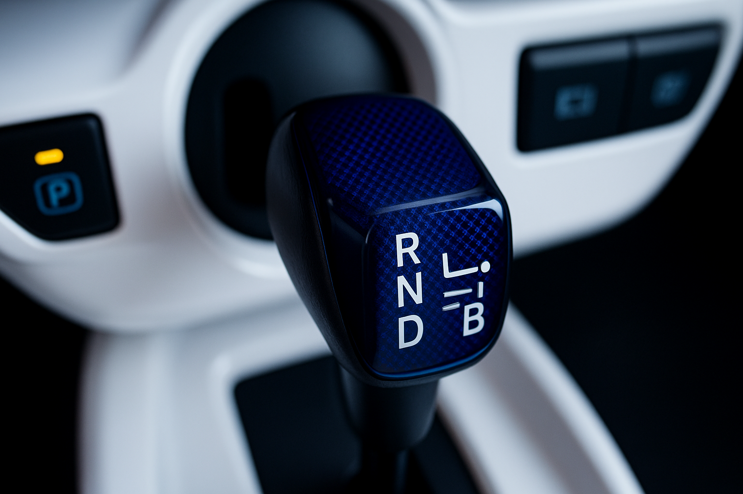

Slide 12
UML State Diagrams Cont…
Illustrates object behaviour by depicting the changing states of an object.
A state is the way an object exists at a particular point in time.
The state of an object is determined by the values of its attributes.
A car with an automatic transmission might have different states: park, reverse, neutral, and drive.
This is similar to states of objects in a software system.
an object is in a certain state, it behaves in a specific way or has attributes set to specific values

Slide 13

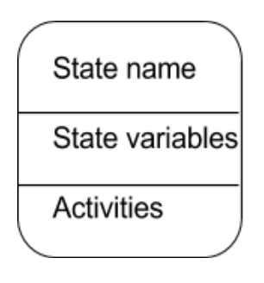
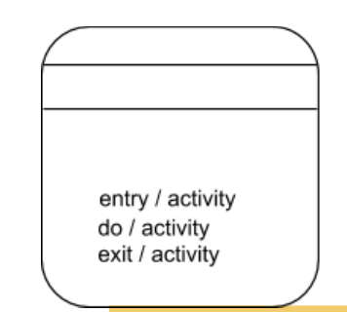
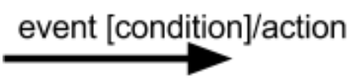
Components of State Diagrams
A filled circle indicates the starting state of the object. Every state diagram begins with a filled circle.
Rounded rectangles indicate other states. These rectangles have three sections: a state name, state variables, and activities.
State names should be short, Each state should have at least a state name.
State variables are data relevant to the state of the.
Object Activities are actions that are performed when in a certain state.
There are three types of activities
Entry
Do
Exit
Arrows indicate transitions from one state to another.

Slide 14

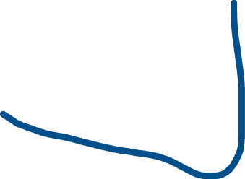


State Name
Enough Coins
State Variables
Insert Coin
[total==price]
State Activites
EntryDo/Exit
Total
Idle
Display Enough
Coins
Insert Coin
Total
Total=0
[total==price]
Dispense Product
Display Total
Insert Coin
[total<price]
Insert more coins
Cancel
Total= 0;
Eject Coins

Slide 15
Components of State Diagrams Cont…
Each transition arrow will always have an event, and it may even have a guard condition and an action. The transition and action happens from a given state if the event occurs and the condition is true.
A circle with a filled circle inside indicates termination.
Termination represents an object being destroyed or the process being completed. Not all diagrams have a termination—some may run continuously.
Can be useful to help determine the events that might occur during an object’s lifetime such as
different user inputs,
how that object should behave when these events occur, like checking conditions and performing actions.
Sometimes it may be easier to see changes in state in a diagram, rather than reading through source code.

Slide 16
Model Checking
In addition to understanding techniques for designing a software system, it is important to know techniques for verifying the system.
is a systematic check of your system’s state model in all its possible states.
helps find errors that other tests cannot
We check all the various states of the software to try and identify any errors, by simulating different events that would change the states and variables of the software.
This exposes any flaws by notifying you of any violation of the rules that occur in the behaviour of the state model.
Typically, model checks are performed by model checking software.

Slide 17
Model Checking Cont…
A software that has a rule not to produce a deadlock
The model checker would simulate the different states that could occur in your system, and if a deadlock was possible, it would provide details of this violation.
A state model is an abstract state machine that can be in one of various states.
The model checker then checks that the state model conforms to certain behavioural properties.
There are three different phases in model checking
Modelling Phase
Running Phase
Analysis Phase

Slide 18
Modelling Phase
This is where you define your system's behavior and rules. You describe what the software does and what properties it should have.
a traffic light system, you'd model its states and define rules like the light must never be green and red at the same time
This is when the model checker does its work. It automatically explores every possible state and event of your model to see if it follows the rules you set.
The model checker would simulate every combination of traffic light changes to see if it ever hits the forbidden "green and red" state.
Running Phase
Notes:
The tool might report, "Violation found: The light turned green and red simultaneously after receiving the 'change_state' signal at the exact moment the system was rebooting.

Slide 19
Analysis Phase
This is the results phase. If the model checker finds a broken rule, it provides a counterexample—a step-by-step description of how the violation happened.
The tool might report, "Violation found: The light turned green and red simultaneously after receiving the 'change_state' signal at the exact moment the system was rebooting.
Model checking helps ensure not only that software is well designed, but also that software meets desired properties and behaviour, and it works as intended

Slide 20
Good Design
A good design manages essential complexities inherent in the problem.
It avoids adding accidental complexities that arise from the solution itself.
Design should be
Maintainable
The cost of system change is minimal
Understandable
Local in effect
Modular
The goal is to achive low coupling and high cohesion.

Slide 21
Solid Design Principles
Are intended to make software design more
Flexible
Understandable
Maintainable
Robert Martin proposed the Solid Design Principles in early the 2000s
The acronym for the five object-oriented design principles being introduced later by Michael Feathers.
These principles are Single Responsibility, Open/Closed, Liskov Substitution, Interface Segregation, and Dependency Inversion
—help developers write more maintainable, scalable, and flexible code.

Slide 22
LSP
SRP
DIP
S O L I D
OCP
ISP

Slide 23
Single Responsibility Principle (SRP)
A class should have only one reason to change
Deals with cohesion
The functional relatedness of the elements of a module
A Class should have only single reposibility, the more responsibilities mean the more reasons to change.
What a class does? The more a class does the more likelky it will change.
The more a class changes the more bugs we will intrduce.
One of the simplest principles, but one of the most difficult to get right.

Slide 24
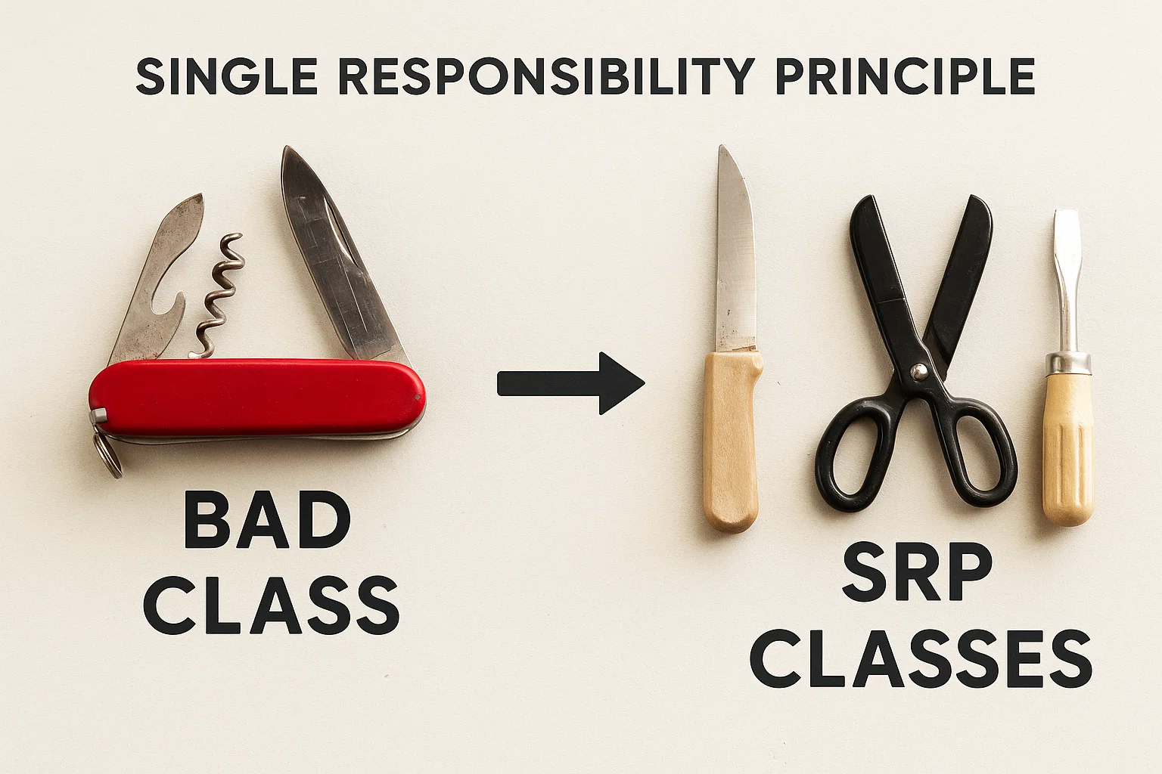

Slide 25
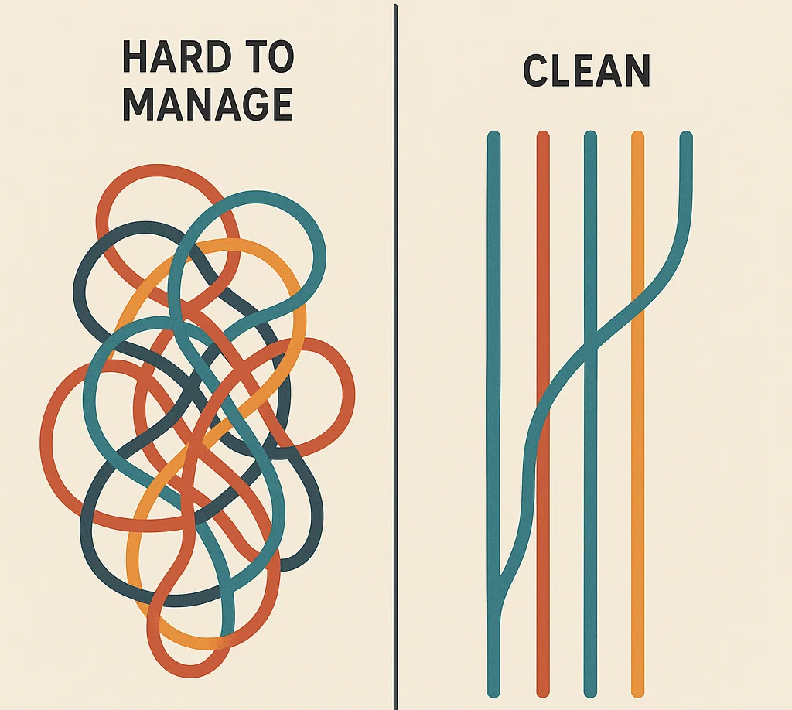
Solid Design Principles Cont…
Finding and separating conjoined responsibilities is much of what software design is really about.
SRP is the most fundamental principle. The rest of the principles are related to SRP in one way or another.

Slide 26
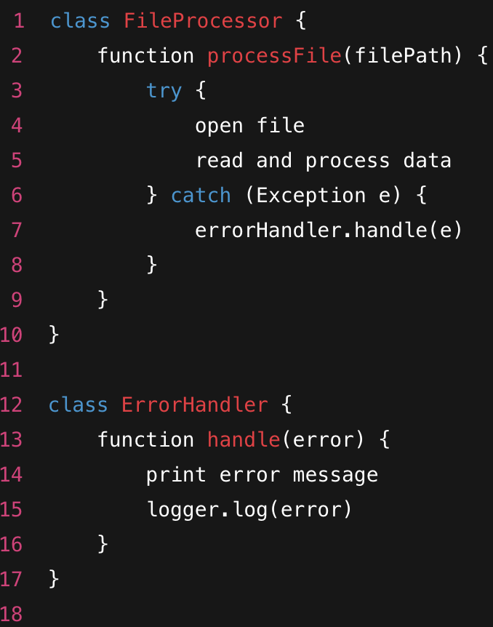
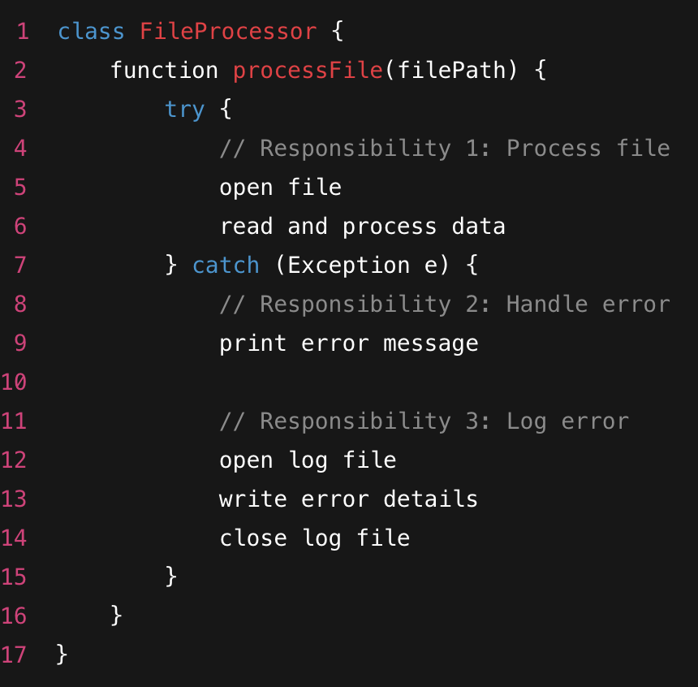

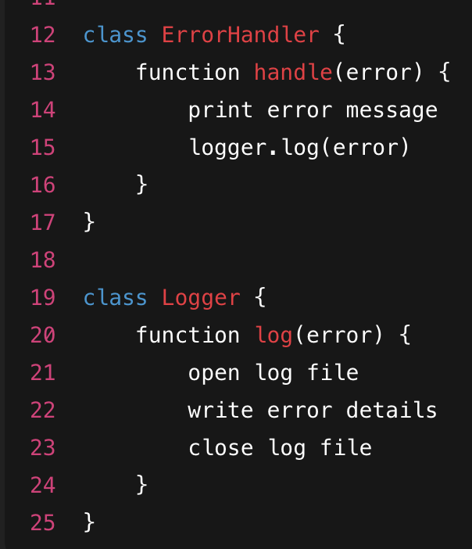
SRP Example
Ok?

Slide 27
Open Closed Principle (OCL)
Software entities (classes, functions, modules) should be open for extension but closed for modification.
Open for extension → You can add new features or behavior.
Closed for modification → You don’t have to change existing working code
Changing existing classes to add new features:
You risk breaking old code.
Bugs sneak in.
It’s hard to maintain.
Instead, write code in a way that allows adding new behavior without editing existing tested code.

Slide 28
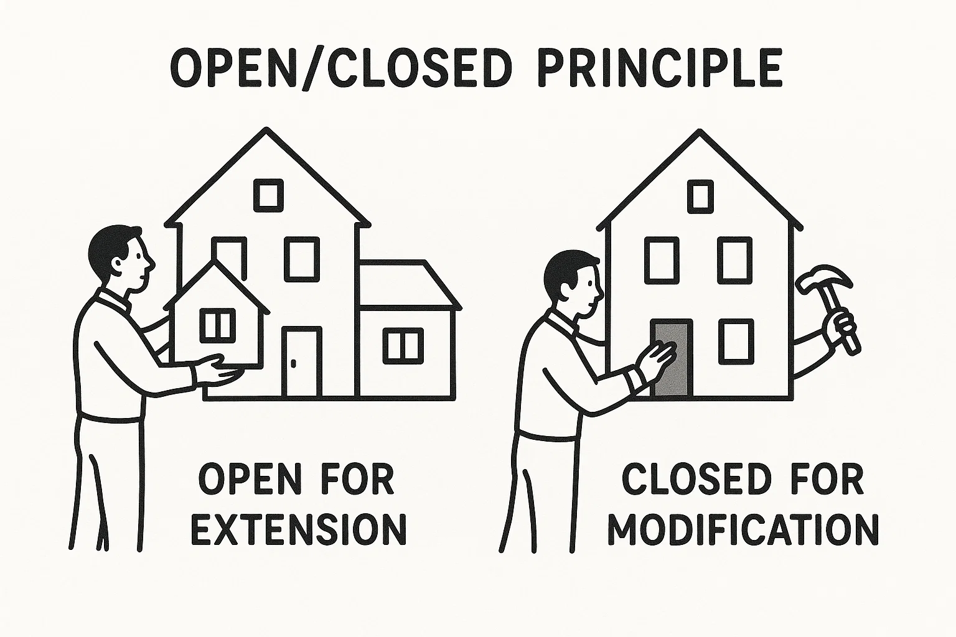

Slide 29
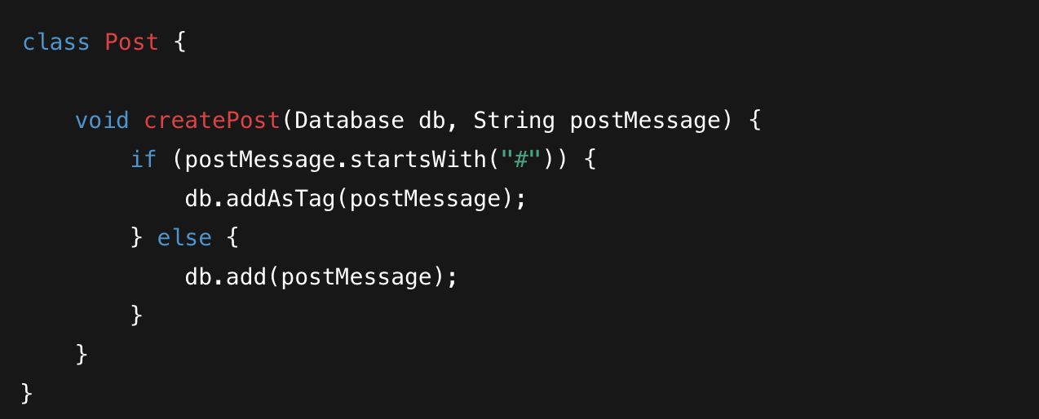

Slide 30
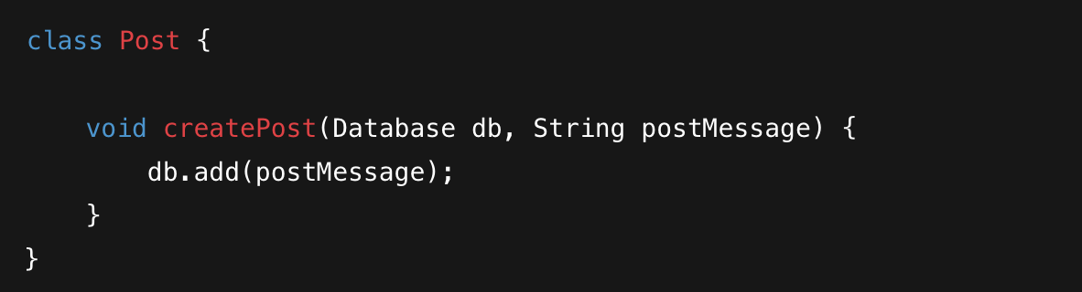
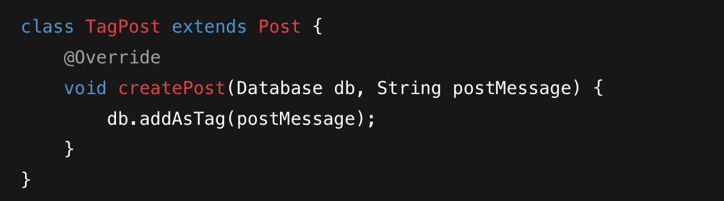
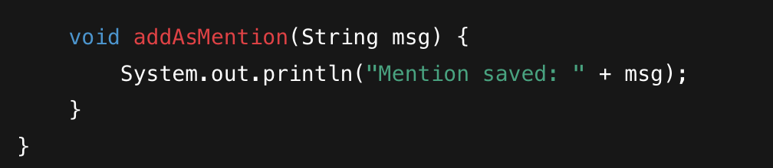

Slide 31
Liskov Substitution Principle (LSP)
Defined by Barbara Liskov in 1987.
Subtypes must be substitutable for their base types.
If S is a subtype of T, objects of type T should be replaceable with objects of type S without breaking the program.
Ensures correct behavior when using inheritance.
Prevents violating expectations of parent class.
Promotes reusability, polymorphism, and robust design.

Slide 32
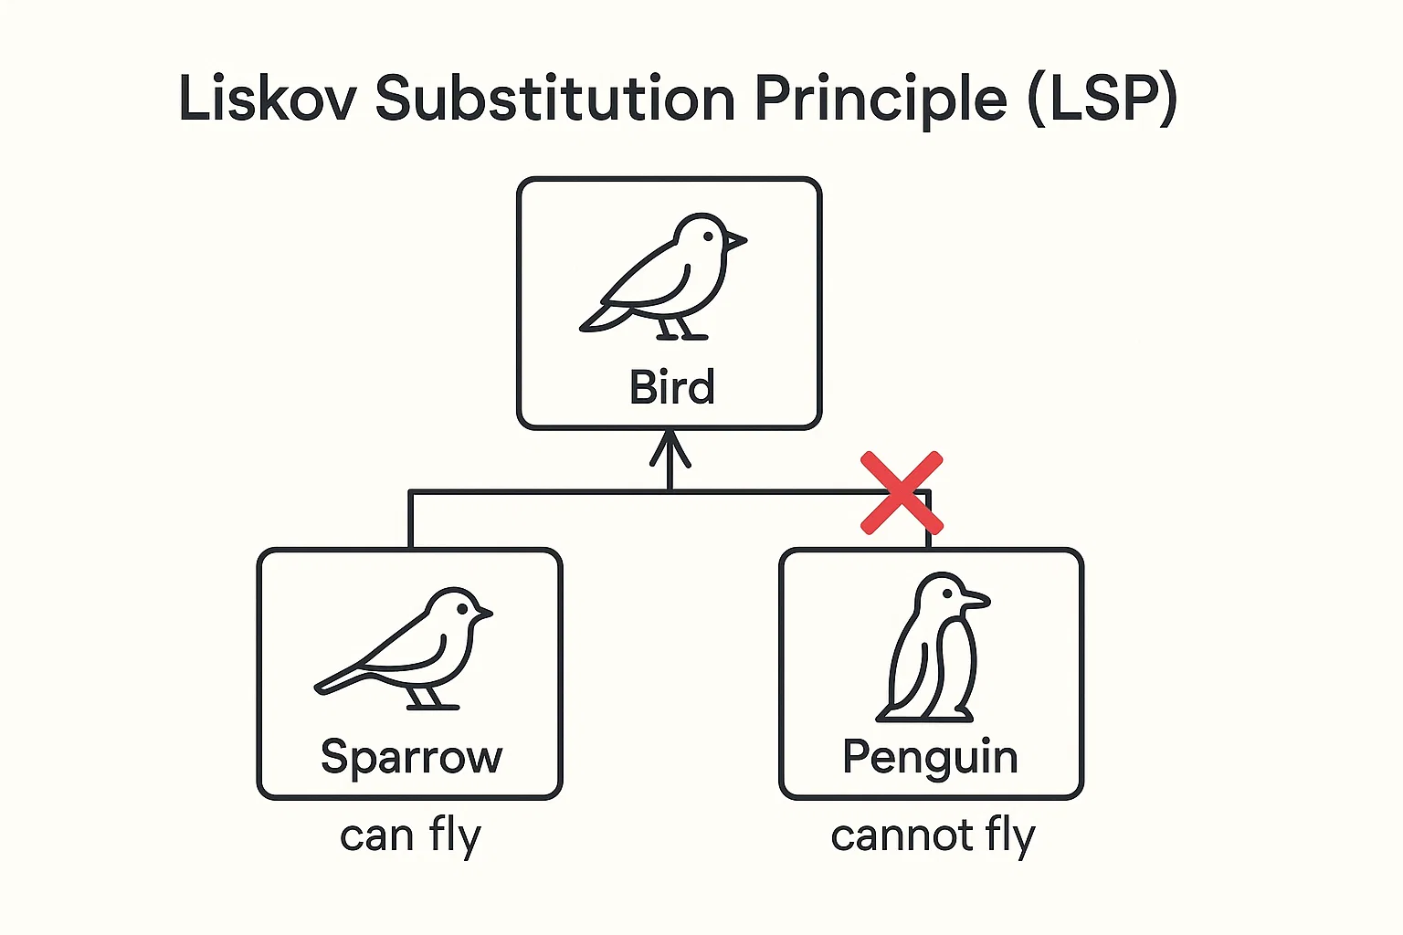

Slide 33
Interface Segregation Principle (ISP)
No client should be forced to depend on methods it does not use.
Instead of having large, “fat” interfaces, break them into smaller, more specific ones.
Promotes high cohesion and low coupling.
Helps avoid situations where implementing classes have to provide empty or irrelevant method bodies.
Leads to flexible, maintainable, and scalable code.

Slide 34




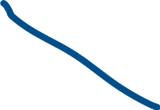





Example
<<interfcae>>
Worker
<<interfcae>>
Workable
<<interfcae>>
Eatable
+Work()
+Eate()
+Work()
+Eate()
Human
Robot
Human
Robot

Slide 35
Dependency Inversion Principle (DIP)
High-level modules should not depend on low-level modules.Both should depend on abstractions (interfaces or abstract classes).
Abstractions should not depend on details.
Details (concrete implementations) should depend on abstractions.
Without DIP, high-level logic becomes tightly coupled to low-level details.
This makes the system rigid (hard to change), fragile (a small change breaks many things), and difficult to test.
With DIP, you can replace low-level components without touching high-level modules.

Slide 36
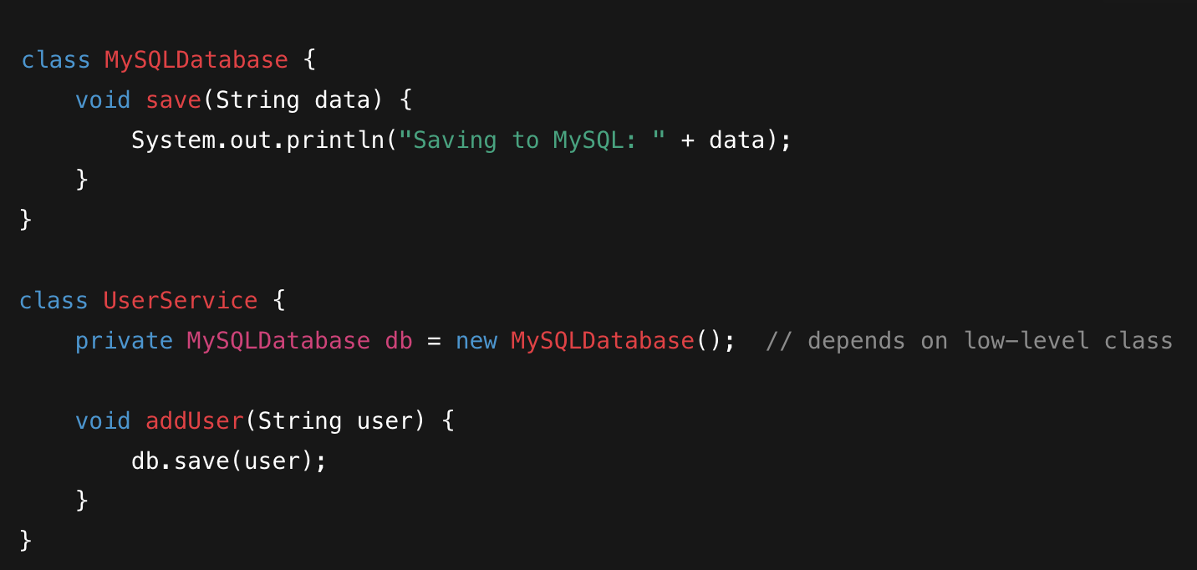





Slide 37
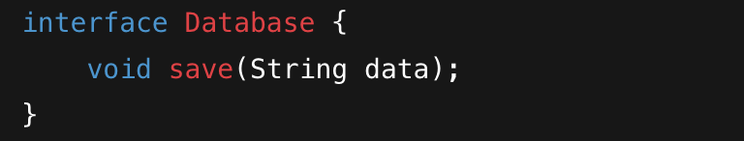
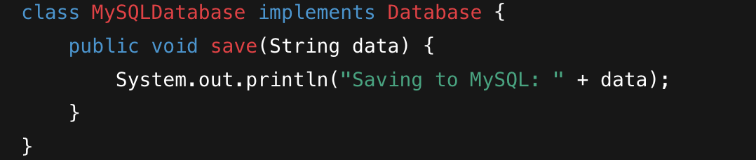
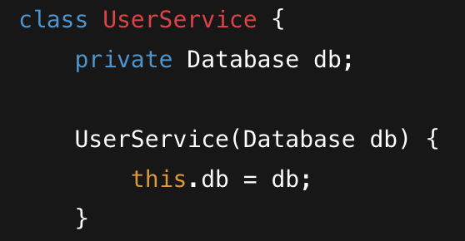
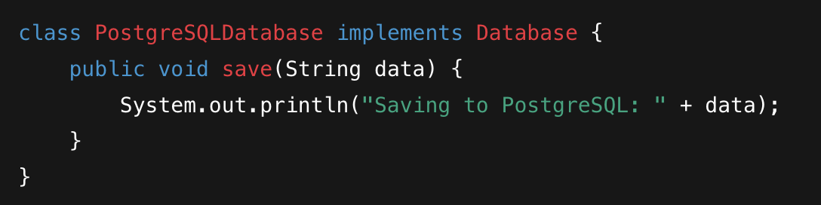


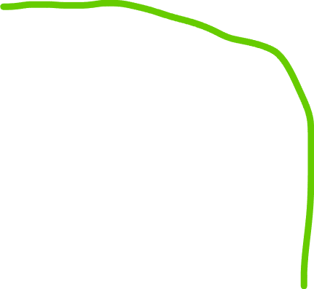



Slide 38
DIP
Natural progression of the Liskov Substitution Principle, the Open Closed Principle and even the Single Responsibility Principle.
Dependency Injection (DI) removes hard dependencies by shifting from composition (tight coupling) to association (loose coupling).

Slide 39
Thank You☺

